Slide 1
SOCIAL CONSCIOUSNESS AND
RESPONSIBILITY
PRESENTED BY
MADHURIMA RAWAT
ROLL NO-29
DATASCIENCE(CSE)
GUIDED BY
VIVEK SIR
CHHATTISGARH SWAMI VIVEKANANDA TECHNICAL UNIVERSITY

Slide 2

WHAT IS SOCIETY ?
Society is defined as a group of people living
as a community or an organized group of
people for a common purpose.
A society is a group of individuals
involved in persistent social interaction.

Slide 3
SOCIAL CONSCIOUSNESS
A social consciousness is a sense of responsibility or concern for the problems and injustices of society".
While our consciousness is related to our moral conduct in our day-to-day lives with respect to individuals, social consciousness is concerned with the broader institutions of society.
Social consciousness is consciousness shared by individuals within a society.Social consciousness is linked to the collective self-awareness and experience of collectively shared social identity.

Slide 4
HOW TO DEVELOP SOCIAL CONSCIOSNESS
1. Pay More Attention To Your Community
2. Act-On A Smaller Scale
3. Find Examples Of Good Practice
4. Maintain A Positive Attitude
5. Rethink What You Are Buying
6. How can I make a difference in other people's lives?"

Slide 5
SOCIAL RESPONSIBILITY
Social responsibility means that businesses, in addition to maximizing profit, should act in a manner that benefits society. Socially responsible companies should adopt policies that promote the well-being of society and the environment while lessening negative impacts on them.

Slide 6
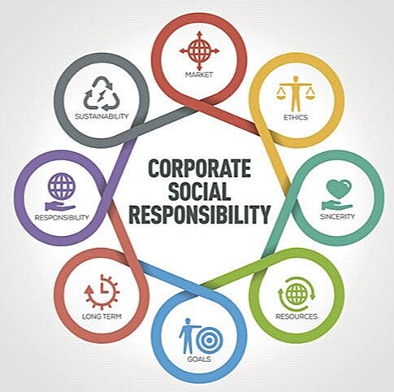
CORPORATE SOCIAL RESPONSIBILITY
Corporate social responsibility, also known as CSR, is the concept that a business has a responsibility to do good. CSR means that a company should self-regulate its actions and be socially accountable to its customers, stakeholders, and the world at large.

Slide 7
TYPES OF CSR
Corporate social responsibility is traditionally broken into four categories:
ENVIRONMENTAL RESPONSIBILITY
PHILANTROPHIC RESPONSIBILITY
ETHICAL RESPONSIBILITY
ECONOMIC RESPONSIBILITY
ENVIRONMENTAL
PHILANTROPHIC
EHICAL
ECONOMIC

Slide 8
ENVIRONMENTAL RESPONSIBILITY
Environmental responsibility refers to the belief that organizations should behave in as environmentally friendly a way as possible. It’s one of the most common forms of corporate social responsibility. Some companies use the term “environmental stewardship” to refer to such initiatives.
Companies that seek to embrace environmental responsibility can do so in several ways:
Reducing pollution, greenhouse gas emissions, the use of single-use plastics, water consumption, and general waste
Increasing reliance on renewable energy, sustainable resources, and recycled or partially recycled materials
Offsetting negative environmental impact; for example, by planting trees, funding research, and donating to related causes

Slide 9
PHILANTROPHIC RESPONSIBILITY
Philanthropic responsibility refers to a business’s aim to actively make the world and society a better place.
In addition to acting as ethically and environmentally friendly as possible, organizations driven by philanthropic responsibility often dedicate a portion of their earnings. While many firms donate to charities and nonprofits that align with their guiding missions, others donate to worthy causes that don’t directly relate to their business. Others go so far as to create their own charitable trust or organization to give back.

Slide 10
ETHICAL RESPONSIBILITY
Ethical responsibility is concerned with ensuring an organization is operating in a fair and ethical manner. Organizations that embrace ethical responsibility aim to achieve fair treatment of all stakeholders, including leadership, investors, employees, suppliers, and customers.
Firms can embrace ethical responsibility in different ways. For example, a business might set its own, higher minimum wage if the one mandated by the state or federal government doesn’t constitute a “livable wage.” Likewise, a business might require that products, ingredients, materials, or components be sourced according to free trade standards. In this regard, many firms have processes to ensure they’re not purchasing products resulting from slavery or child labor.

Slide 11

ECONOMIC RESPONSIBILITY
Economic responsibility is the practice of a firm backing all of its financial decisions in its commitment to
do good in the areas listed above.
The end goal is not to simply maximize
profits,but positively impact the environment, people, and society.

Slide 12
HOW TO DEVELOP SOCIAL RESPONSIBILITY
Food drives, volunteering in food pantry, developing recycling programs, raising awareness of an environmental issue, collecting much needed items for disaster relief victims are all possible activities that can serve to deepen social responsibility.
This are all the ways by which we as individuals can develop social responsibility.

Slide 13
THANK YOU FOR LISTENING TO MY PRESENTATION
ANY QUESTIONS

